Slide 1

TASK 1 : Deploy a Scalable Web Application on AWS Cloud
Ankumpeta Vimala

Slide 2
CONTENTS
Introduction
System Requirements
EC2 Instances
Set up IAM and Access Permissions
RDS for database storage
S3 for static files.
Deploy Application Code
Configure Load Balancing and Auto Scaling
Database Setup and Management
Monitoring and Logging
Testing and Validation
Conclusion
Resources and References

Slide 3
INTRODUCTION
OBJECTIVE:
Deploy a scalable web application on AWS Cloud using various AWS services, ensuring high availability, performance, and security.

Slide 4
System Requirements
1.Launch an EC2 Instance
Login to AWS Console
Navigate to EC2.
Click "Launch Instance."
Choose the "t2.micro" instance type.
Configure other settings (VPC, security groups, key pair, etc.).
Security groups Port - 80 for HTTP, Port- 22 for SSH.
Launch the instance.

Slide 5
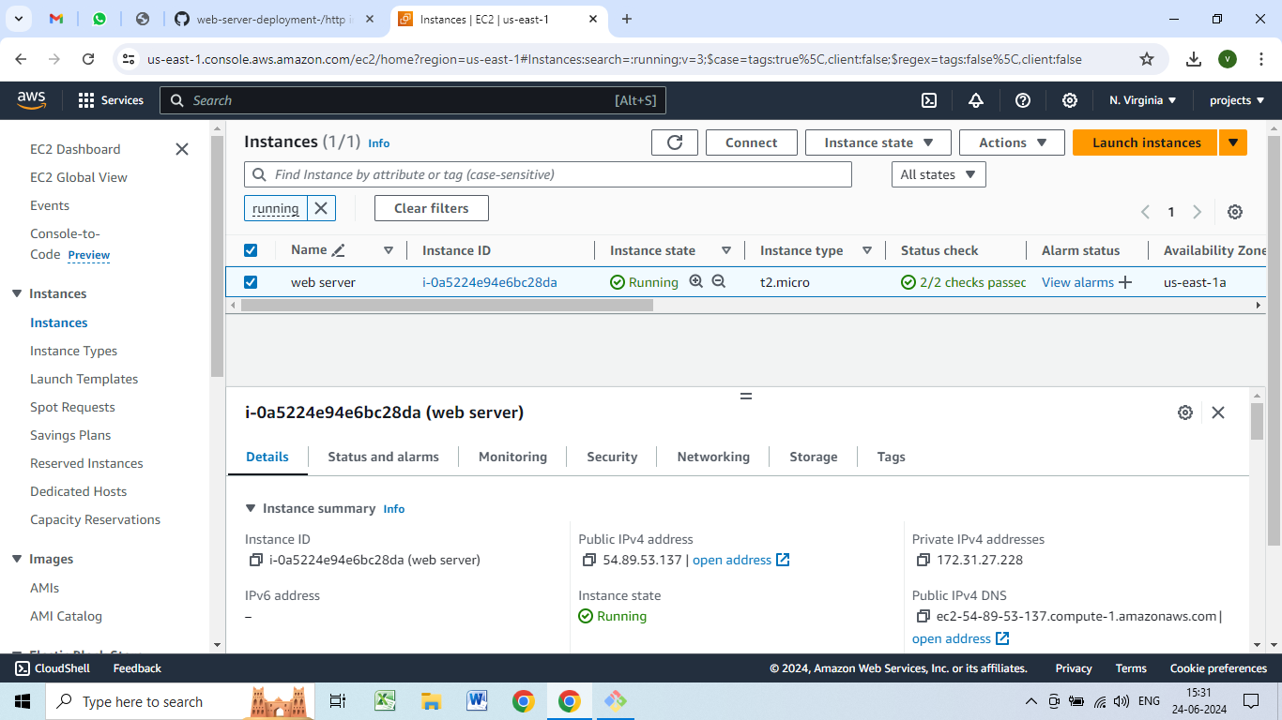
Create a web sever by using EC2 instance

Slide 6
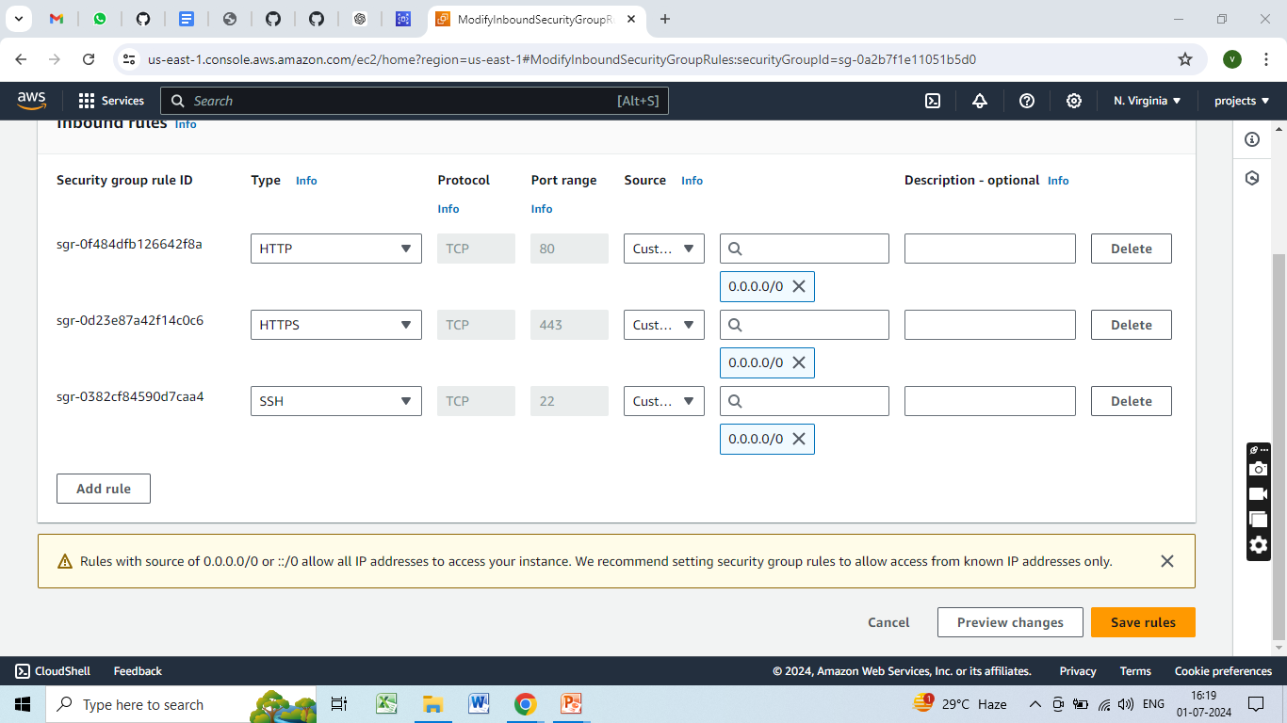
Creating Security Groups

Slide 7
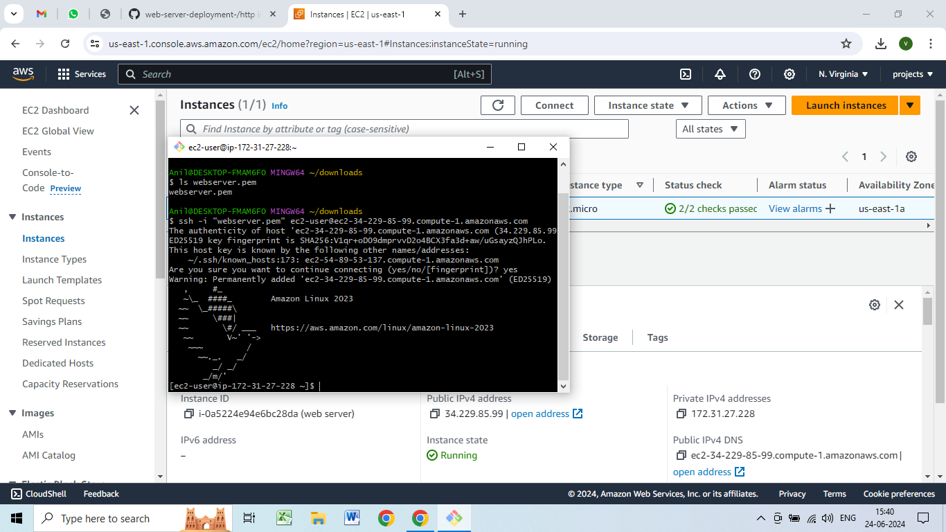
Login to sever by using Gitbash

Slide 8
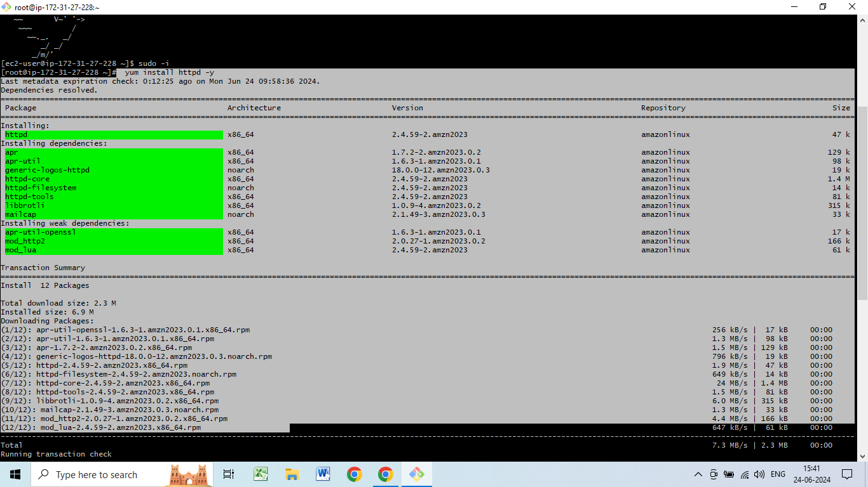
Installing HTTPD

Slide 9
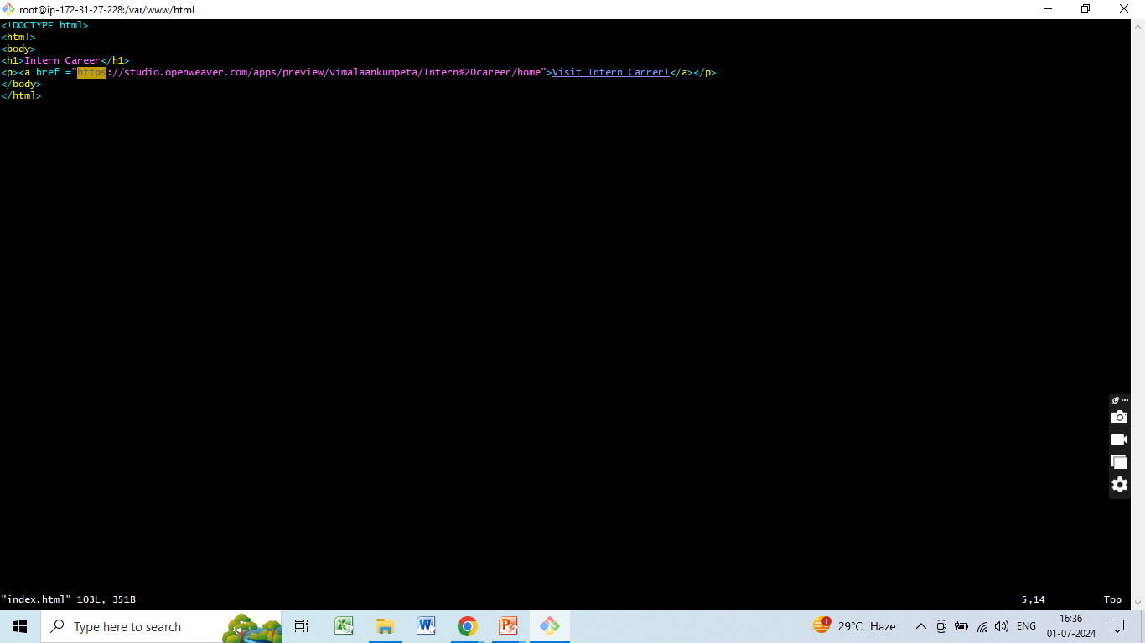
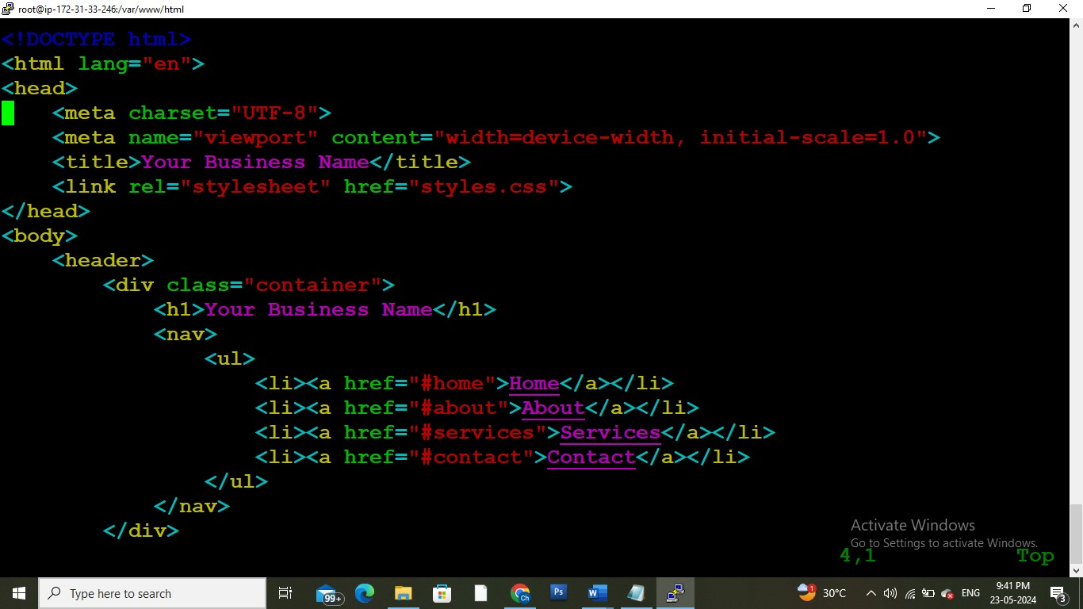
Creating a Web application

Slide 10
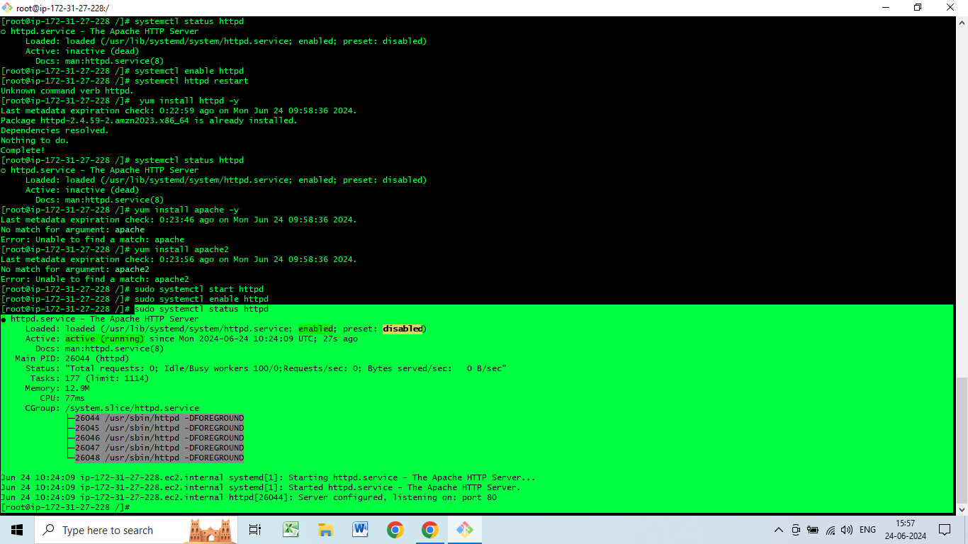
Restarting httpd

Slide 11
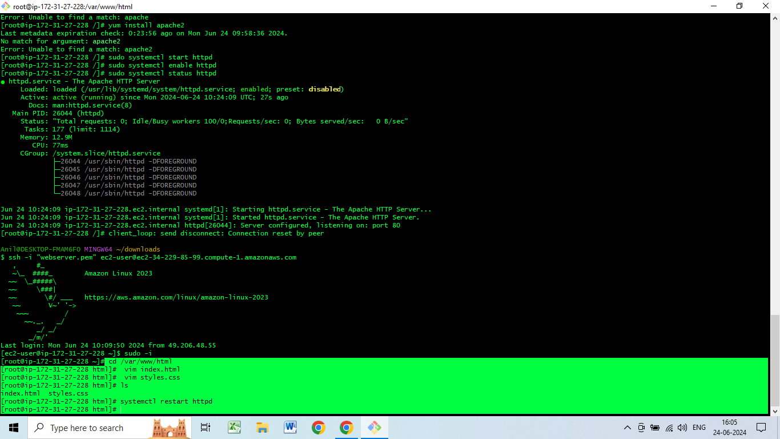
Deploying the web application to the server

Slide 12
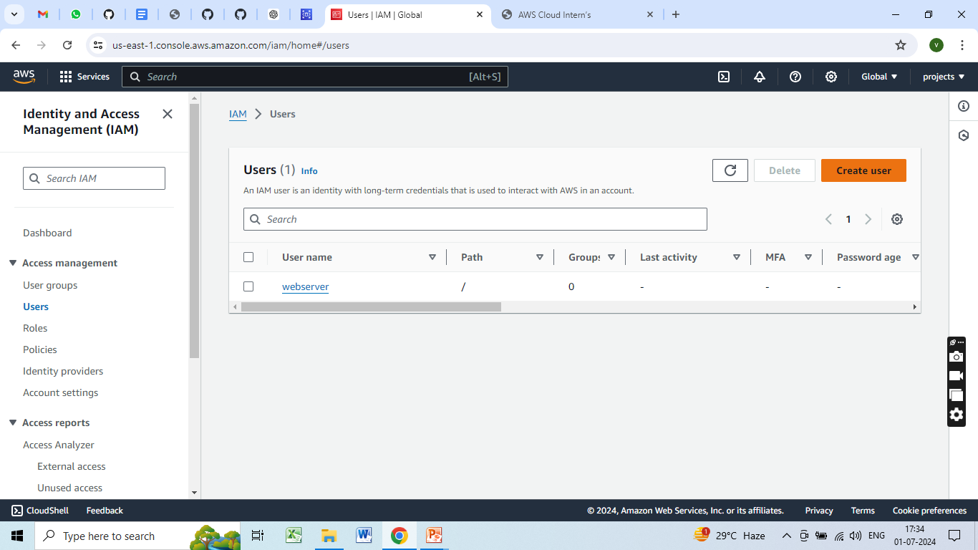
Created IAM User

Slide 13
Creating MySQL Database
Launch RDS Instance:Go to the RDS Dashboard and click Create database.
Choose the database engine (e.g., MySQL).
Select Standard Create and configure the instance details, such as instance class, storage type, and Multi-AZ deployment.
Configure connectivity settings, ensuring it’s within the same VPC as your EC2 instances.
Set up database authentication and additional configuration (e.g., backups, maintenance).
Create the database.

Slide 14
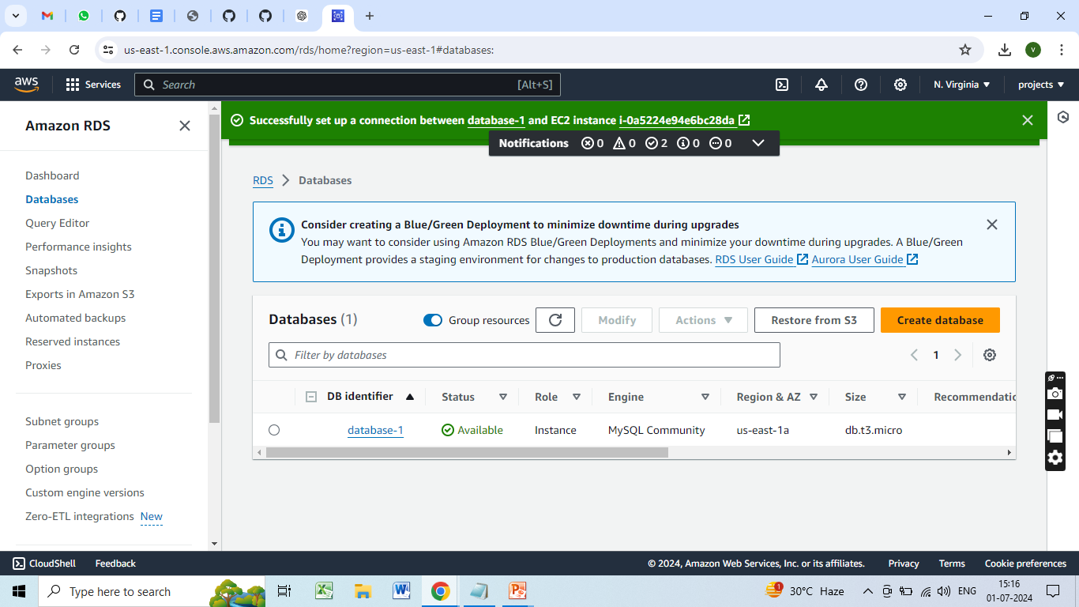
MySQL Database

Slide 15
Creating an S3 Bucket
Log in to the AWS Management Console.
Navigate to S3 and click Create bucket.
Bucket Settings:
Bucket name: Enter a unique name (e.g., my-static-site-bucket).
Region: Choose your preferred region.
Block Public Access Settings: Uncheck "Block all public access" and acknowledge the warning.
Bucket Configuration: Click Create bucket.

Slide 16
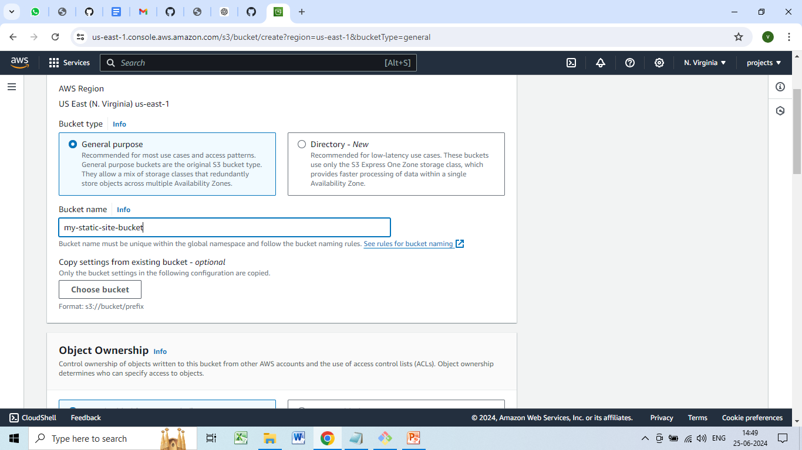
Bucket Settings

Slide 17
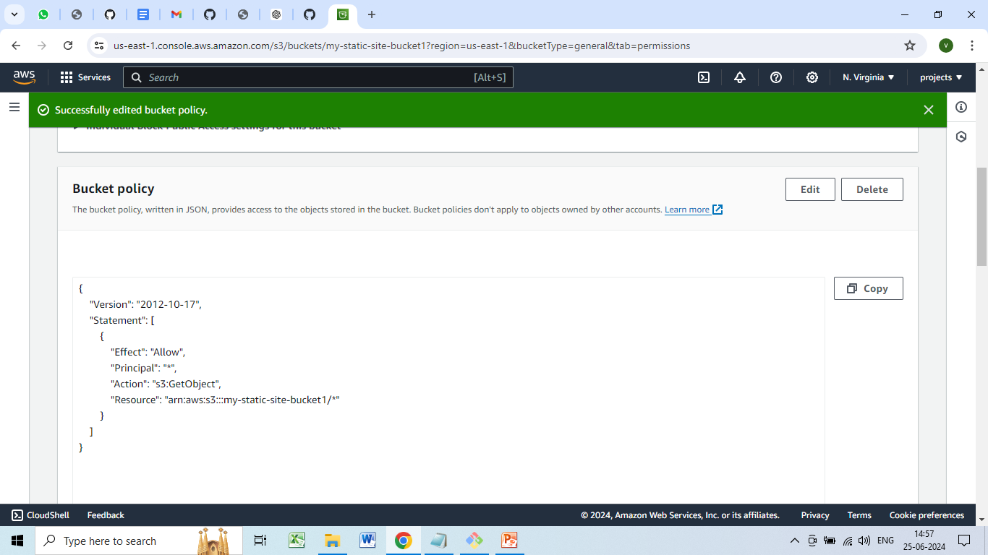
Bucket policy

Slide 18
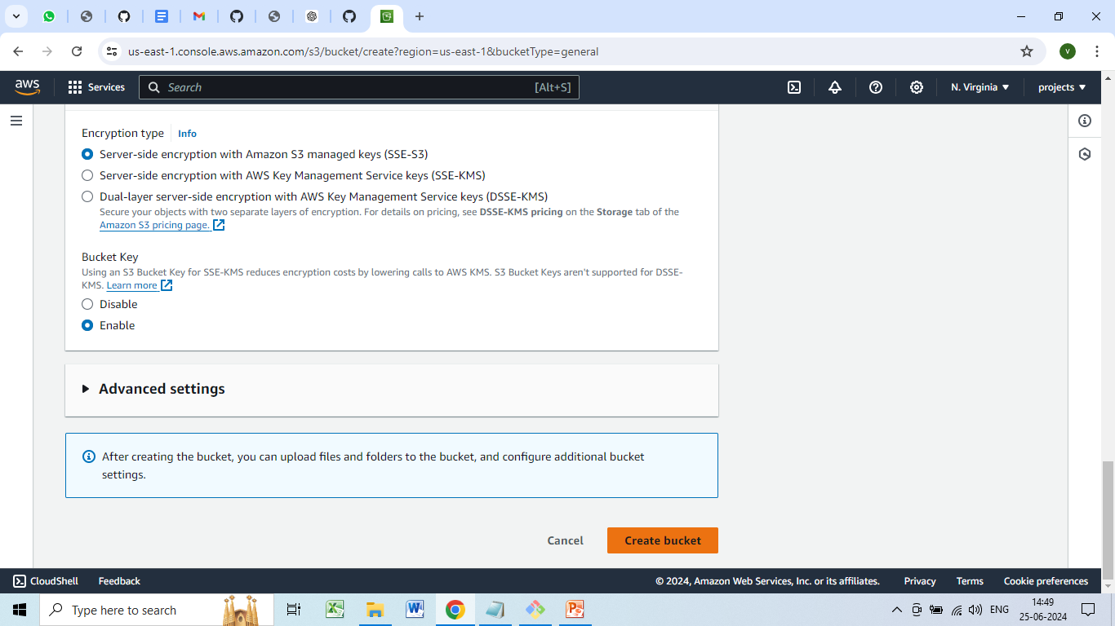
Bucket Configuration

Slide 19
Configure the S3 Bucket for Static Website Hosting
Go to the newly created bucket.
Properties tab → Static website hosting.
Static website hosting:
Hosting type: Select "Use this bucket to host a website".
Index document: Enter index.html.
Error document: Enter error.html(optional).
Save changes.

Slide 20
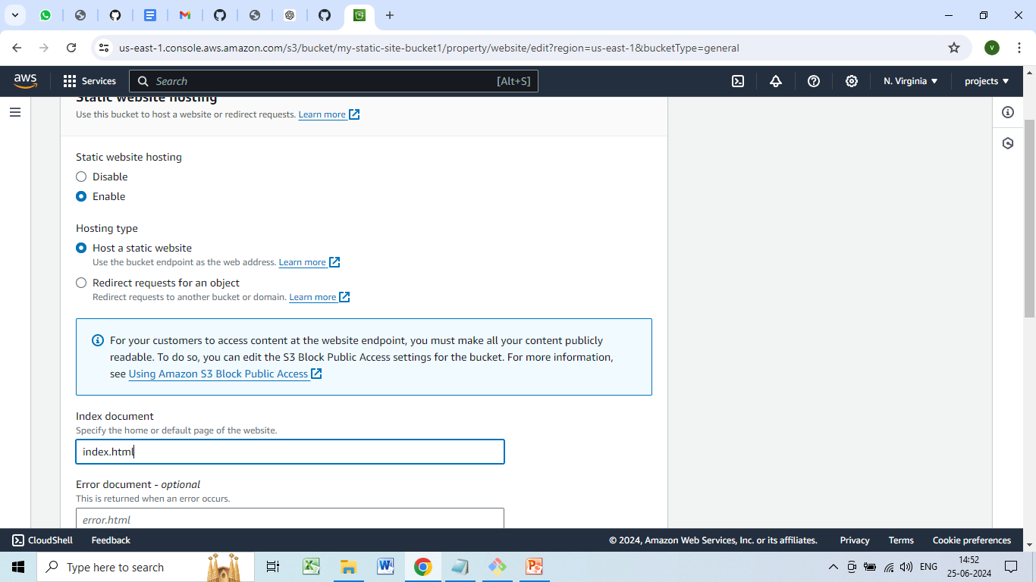
Static website hosting

Slide 21
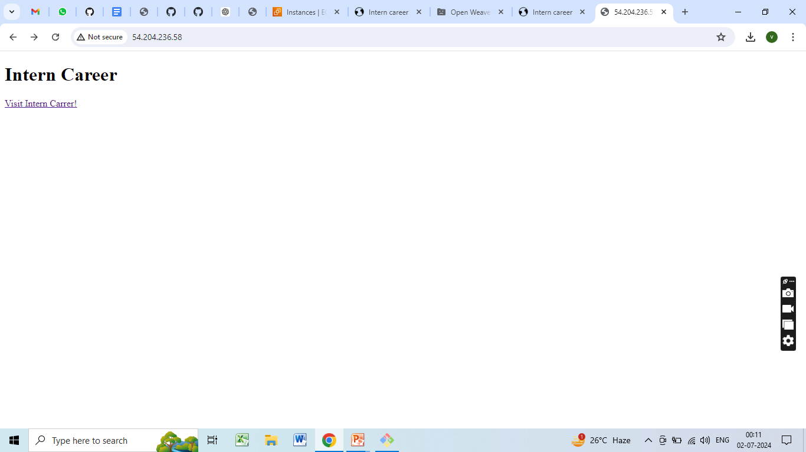

Slide 22
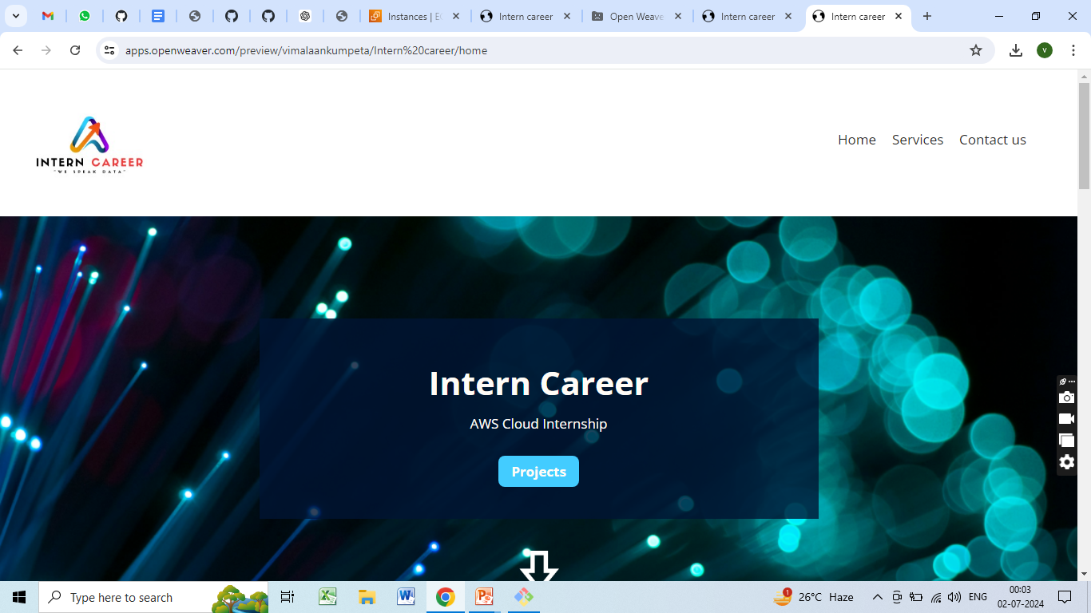

Slide 23
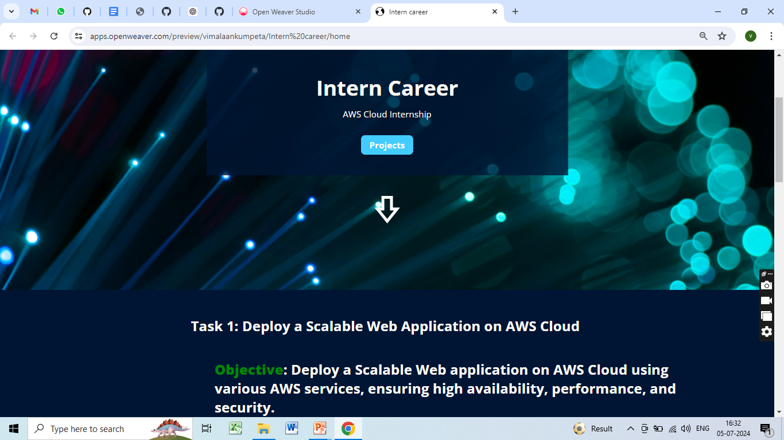

Slide 24
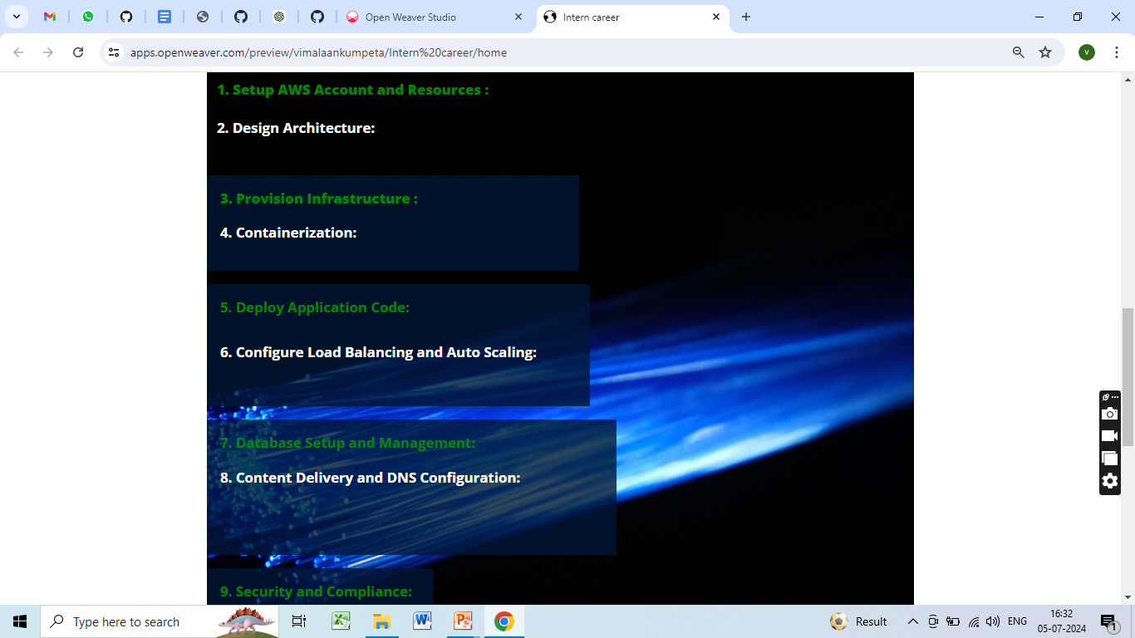

Slide 25
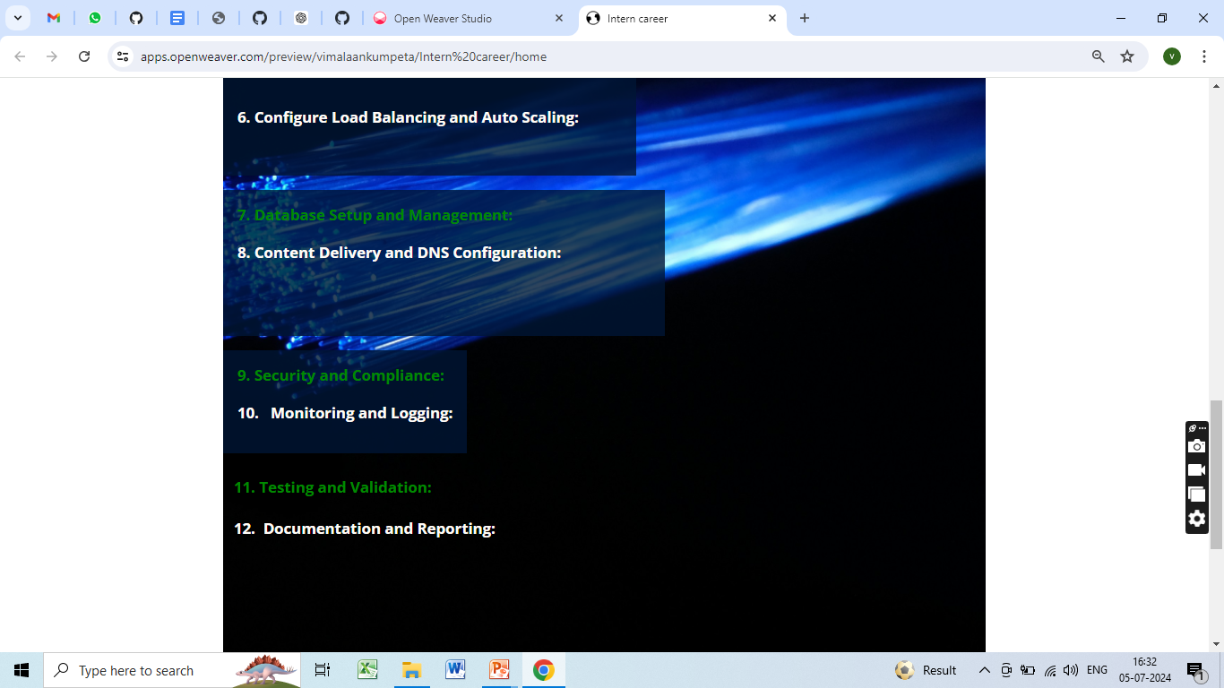

Slide 26
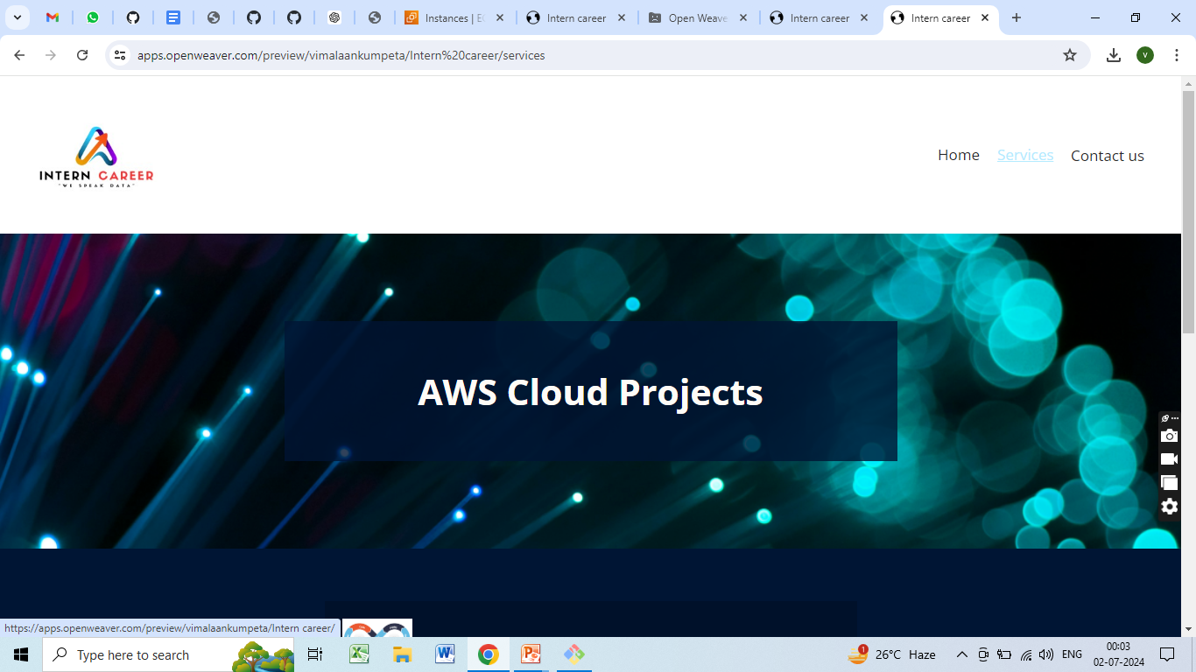

Slide 27
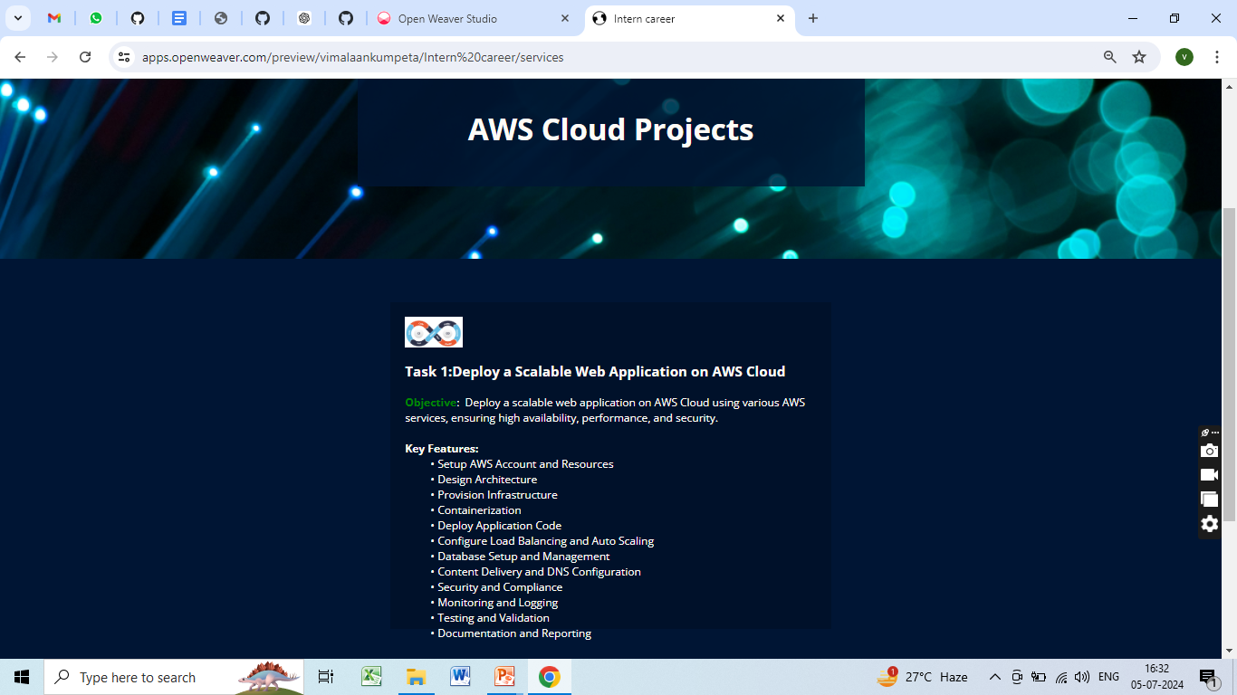

Slide 28


Slide 29
Creating Autoscaling Group
Create an Autoscaling Group and associate it with the EC2 instances.
Configure launch configurations with details like the Amazon Machine
Image (AMI), instance type, and user data script.
Define scaling policies based on CPU utilization.
For example,
This example sets an alarm that triggers when the average CPU utilization is greater than 80% for one consecutive 5-minute periods.

Slide 30
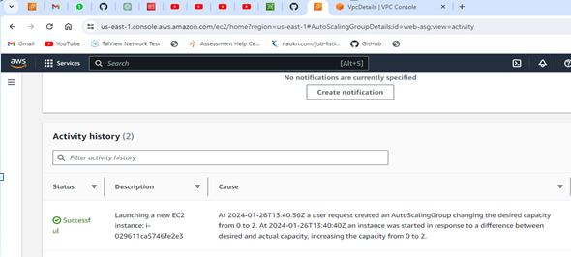

Slide 31
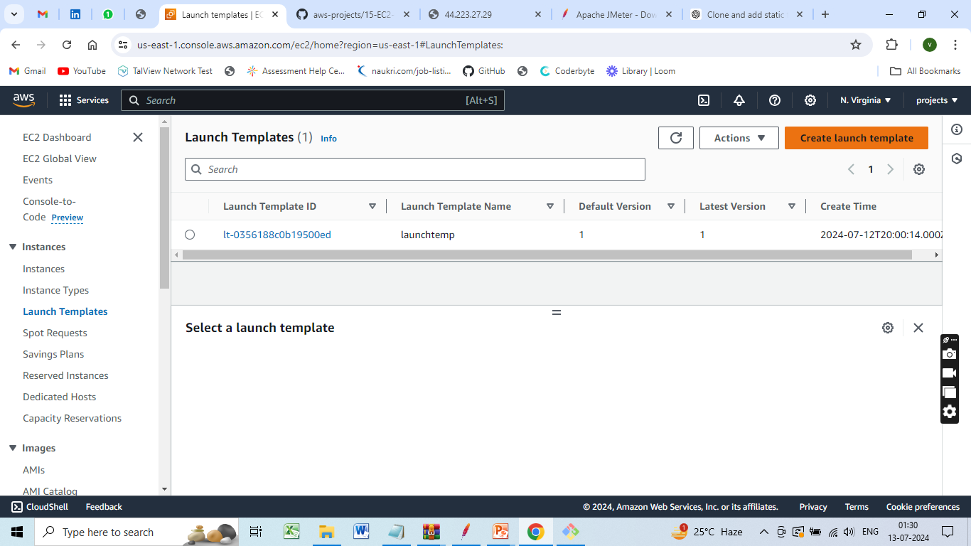
Create launch template

Slide 32
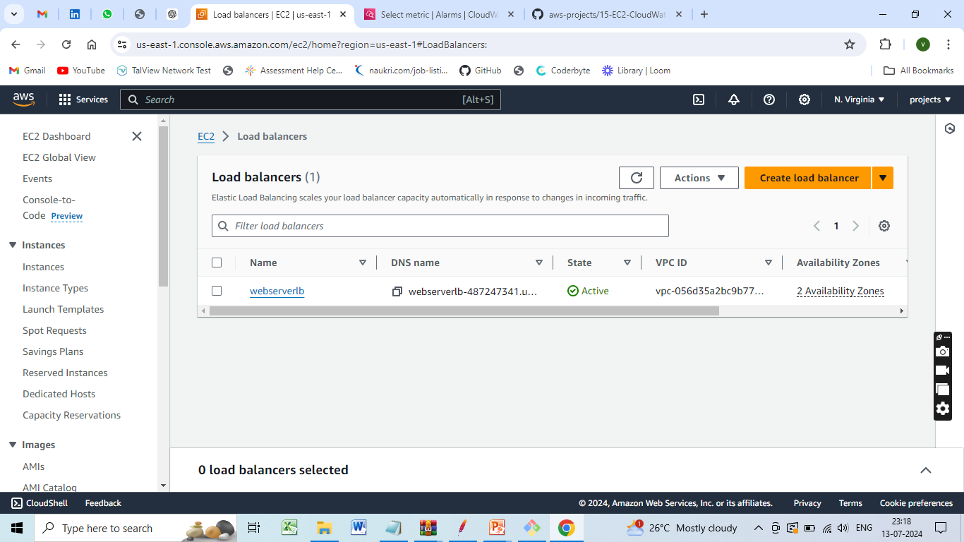
Creating Load Balancer

Slide 33
Creating Load Balancer
Create an Elastic Load Balancer (Application Load Balancer or Network Load Balancer).
Configure listeners and target groups to route traffic to instances in the Autoscaling Group

Slide 34
Logging and Monitoring
Enable logging on the load balancer and instances.
Set up CloudWatch Alarms to trigger based on CPU usage and other relevant metrics.
Monitor logs and alarms to troubleshoot any issues

Slide 35
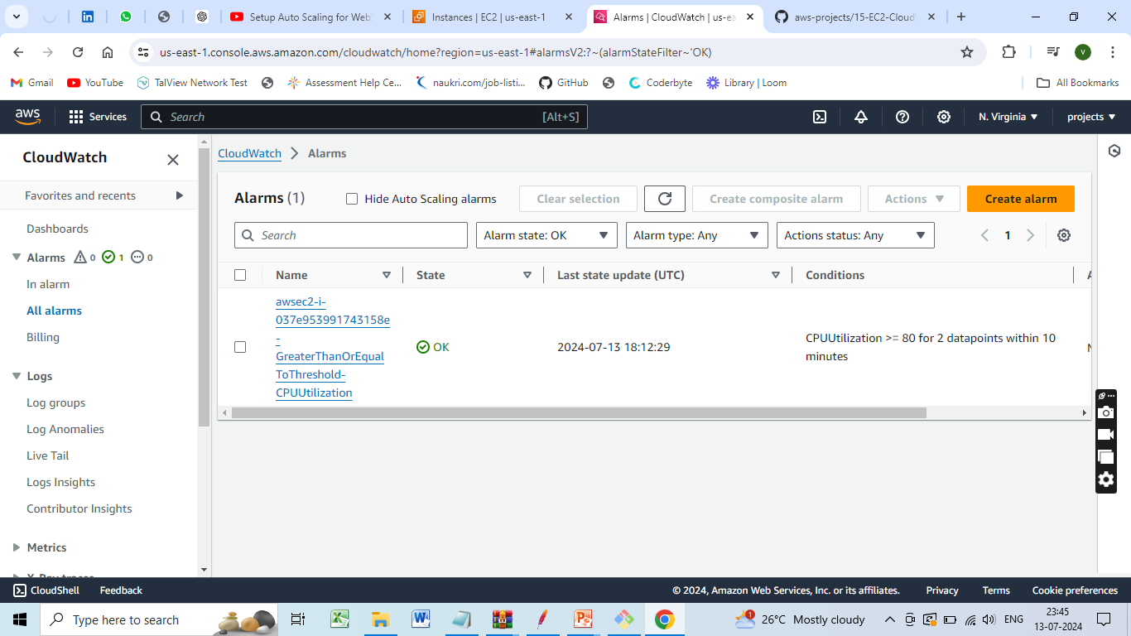
AWS services such as CloudWatch to automate scalability and elasticity
1,Set Up Cloud Watch Alarms

Slide 36
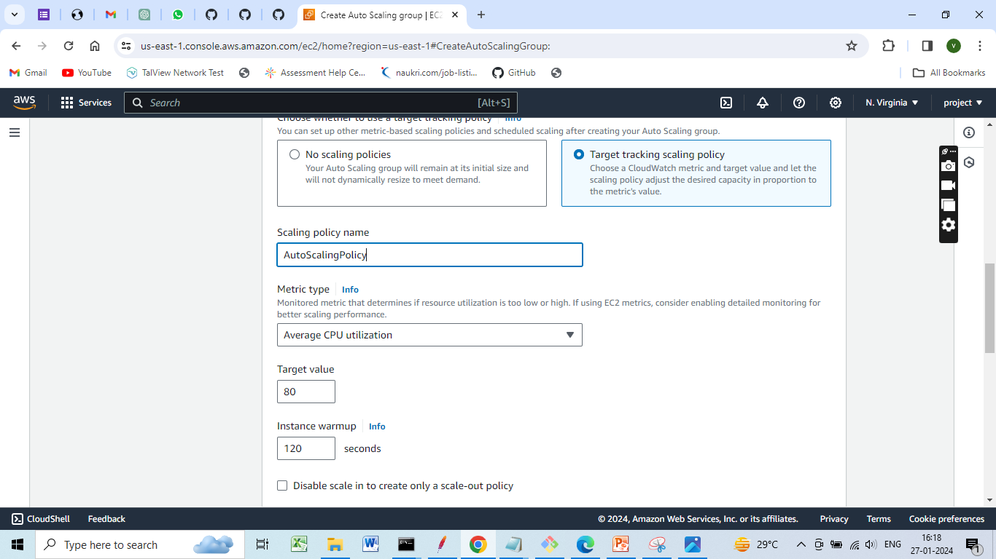
Define Auto Scaling Policies

Slide 37
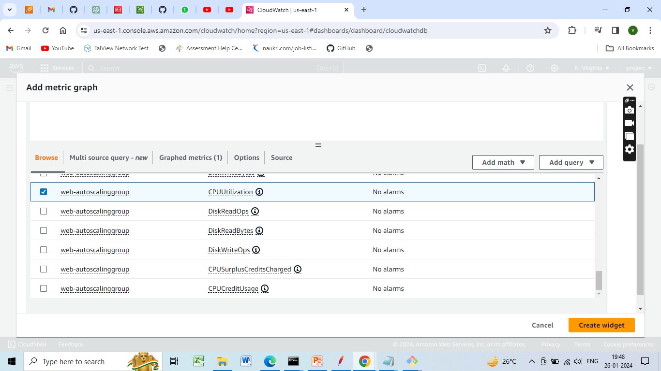
Cloud Watch metrics

Slide 38
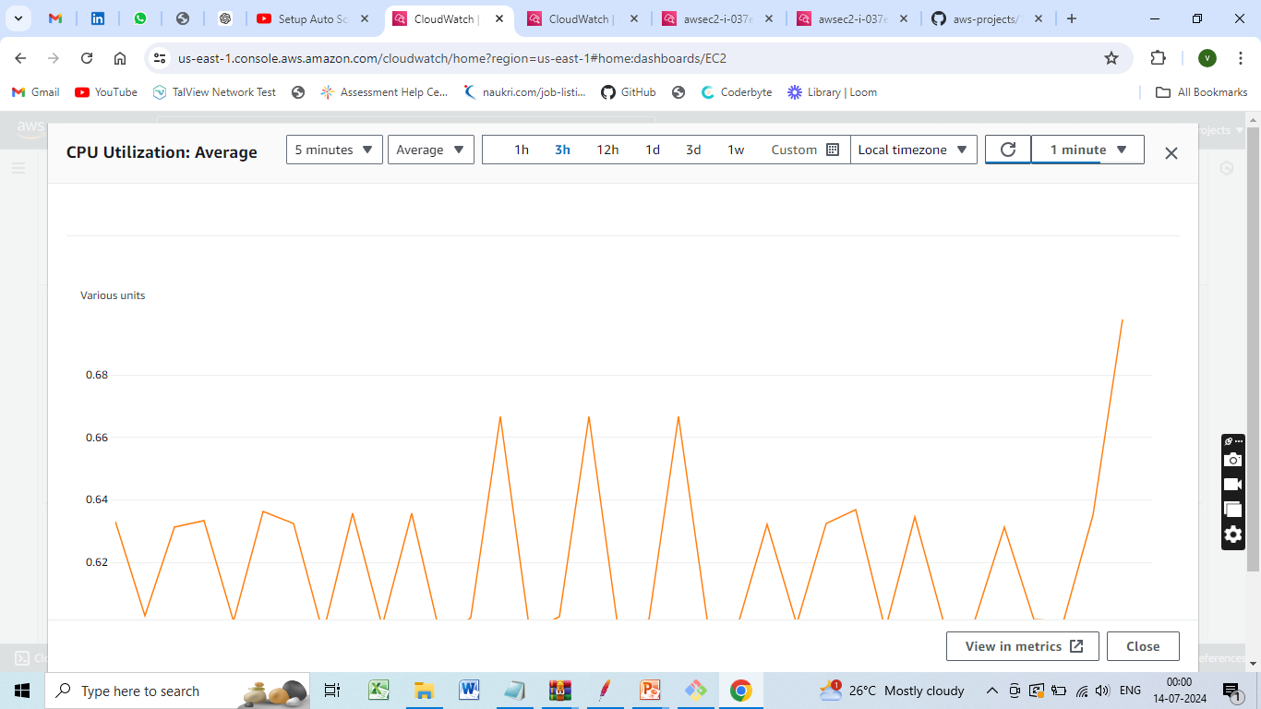
Graph Showing CPU Utilization

Slide 39
Testing and Validation:
Test the deployed web application for functionality, performance, scalability, and reliability under varying loads.
Conduct load testing, stress testing, and security testing to validate the application's resilience and responsiveness.

Slide 40
Comprehensive testing strategy
Performance testing
Performance Testing is a process of testing a software application under a specific workload
Testing is performed to test the speed reliability response time and resource usage
The focus is on identifying and eliminating any resistances in the software application

Slide 41

Tool used for performance testing
Jmeter
The Apache JMeter is an open-source purely java based software
It is used to test load testing functional behaviour and measuring performance
Initially, Jmeter was developed to test applications but now has expanded to other test functions.

Slide 42
Installing jmeter tool
Prerequisites to Install Jmeter
Since Jmeter is purely java –based, having Java on the desktop is a must.
Jmeter is compatible with Operating Systems like:
Linux
Windows
Mac OS
Ubuntu

Slide 43
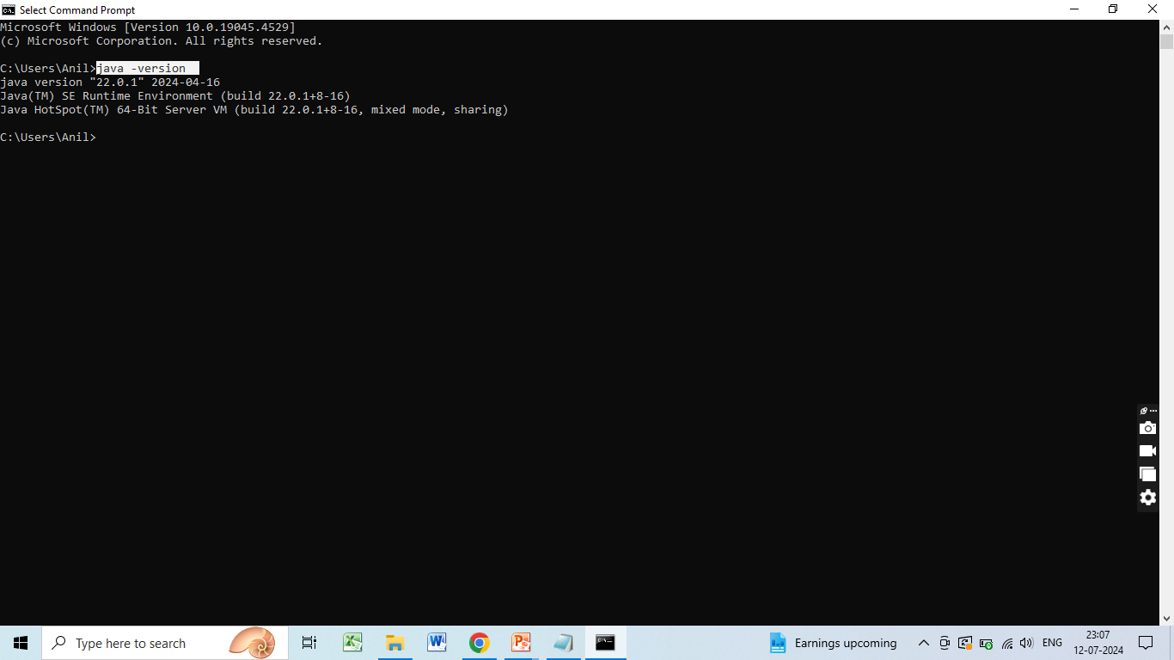
1.Check if Java Is Installed
Open the command prompt
Put the command java –version

Slide 44
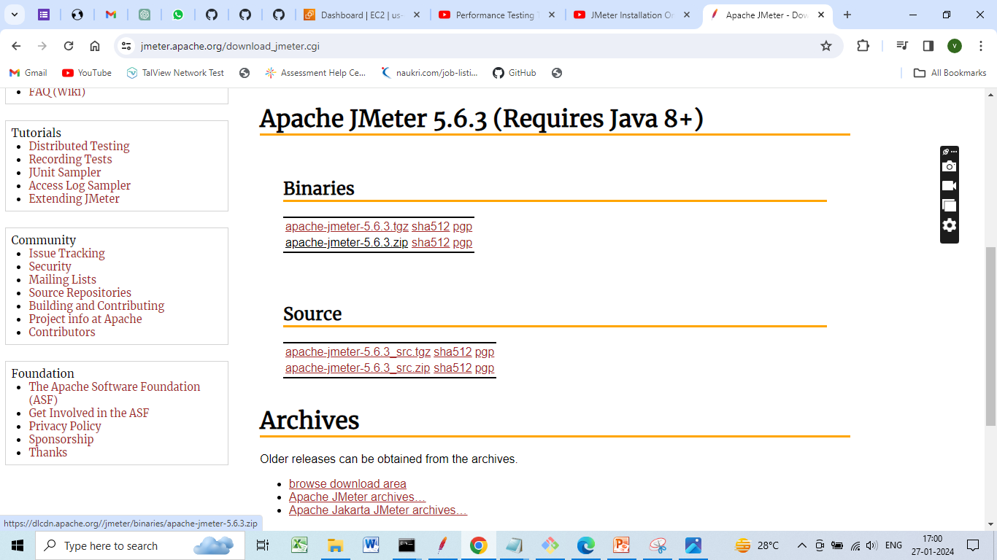
2.Download Jmeter
To download JMeter go to the Apache JMeter website
https://jmeter.apache.org/download_jmeter.cgi
On the website go to the binaries section and download the zip file
Wait for the zip folder to be downloaded

Slide 45
3. Install JMeter
Once the zip folder is downloaded, go to the folder location, and then extract the zip folder
Once the folder is extracted go inside that folder and then go inside the bin folder here
In the bin folder open the jmeter.bat file

Slide 46
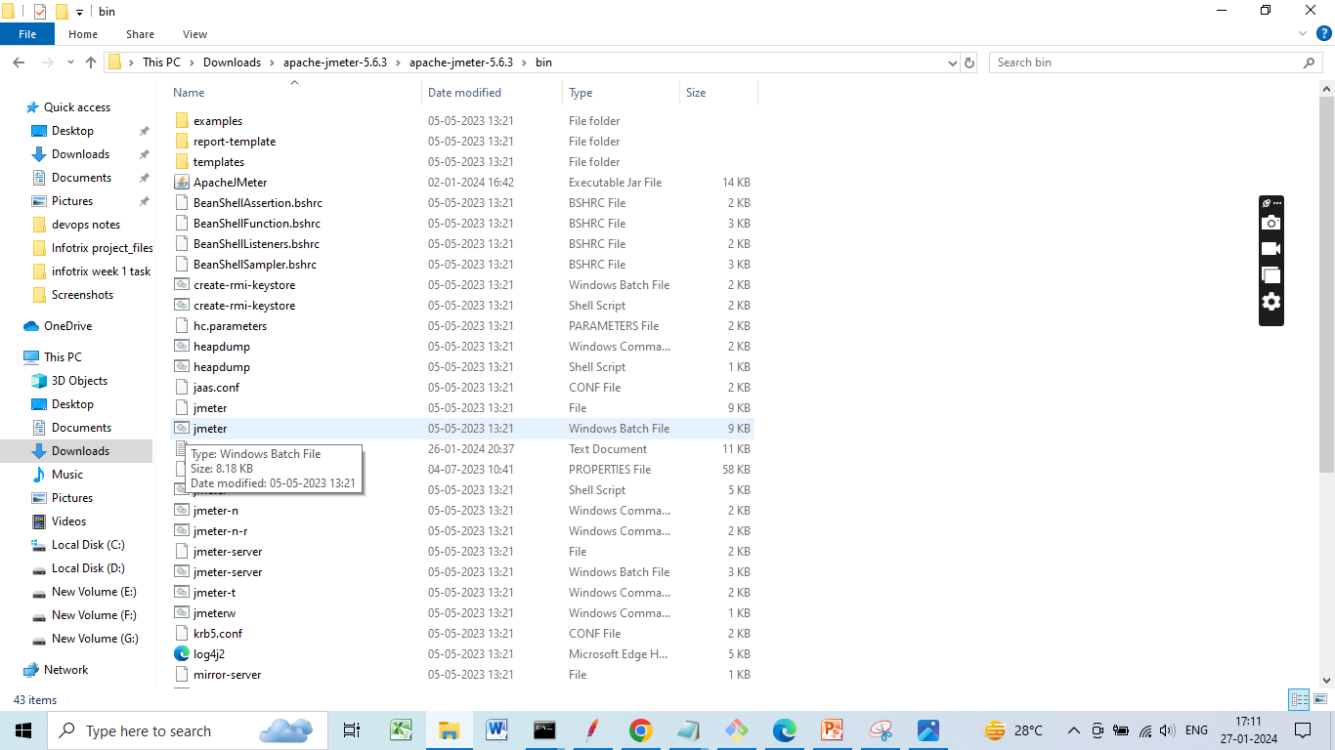
JMeter.batch file

Slide 47
4. Create the First test plan
The first step in creating the test plan is
Adding a Thread Group
Open the JMeter window
The window is divided into two parts. The left side has all the added elements, while the right side has all the elements' configurations.
Rename the test plan and save it
Now, rename it as the FirstJMeter.
Right-click on the test plan.
Go to add -> Threads (Users) -> Thread Group

Slide 48
Now, once you click on the Thread Group, there are three things on the screen that are important concerning the load test:
The number of threads (users):
This is the number of threads or users JMeter will simulate.
Let's make it 100.
Ramp-Up Period (in seconds):
This is the time that JMeter takes before starting the thread over.
Let’s keep this as 12.
Loop Count:
This is the number of times the test will be executed.
And this one, let's leave it to be 10

Slide 49
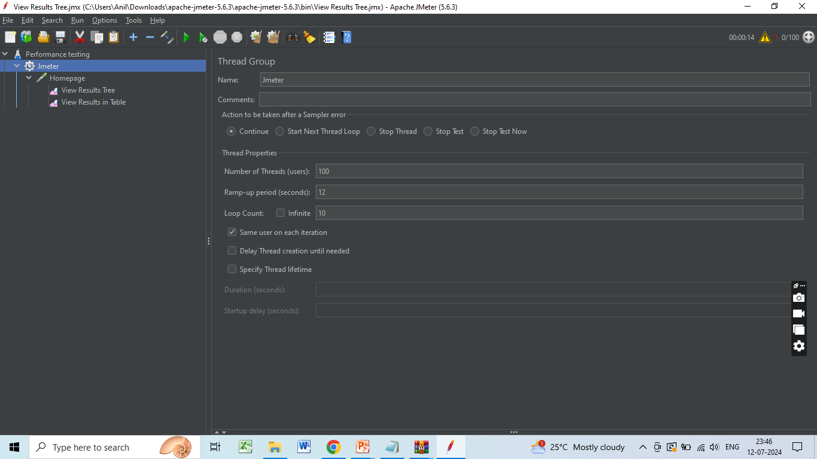

Slide 50
Add an HTTP Request
Right-click on FirstJMeter and again go to add
In the drop-down select samplers
These are all the types of requests that JMeter can work on.
For now, choose the simplest of them all, the HTTP request.
Here you will have to give the address to some home pages or websites.

Slide 51
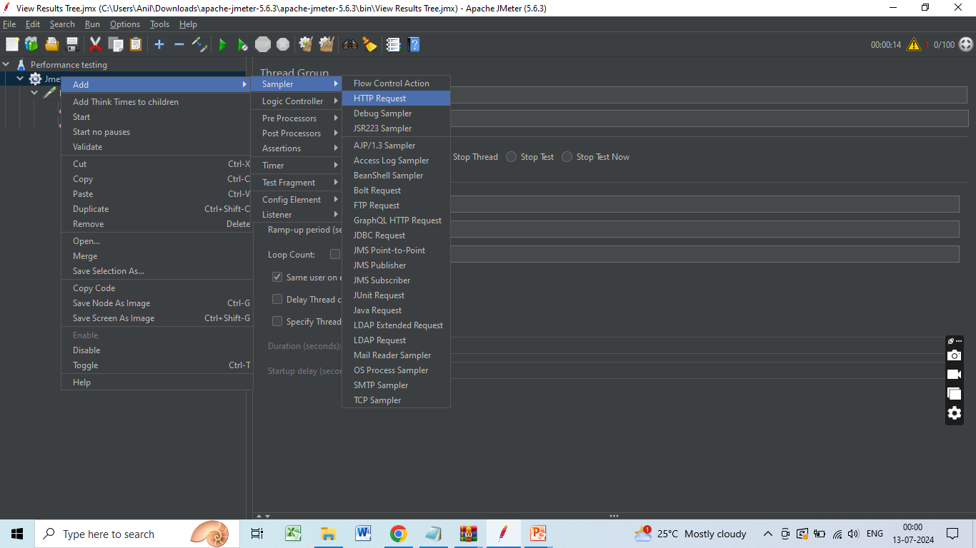

Slide 52
Now, rename it to be HomePages.
Here, in the Server Name or IP box, you have to give the server name or the IP.
Copy the IP
Come back to the JMeter window and paste it into the Server Name box
Don't give HTTP or HTTPS since these are protocols that will come in the other box. They will be automatically taken in the HTTP request case.
Then in the path dialog box, leave a forward slash there.

Slide 53
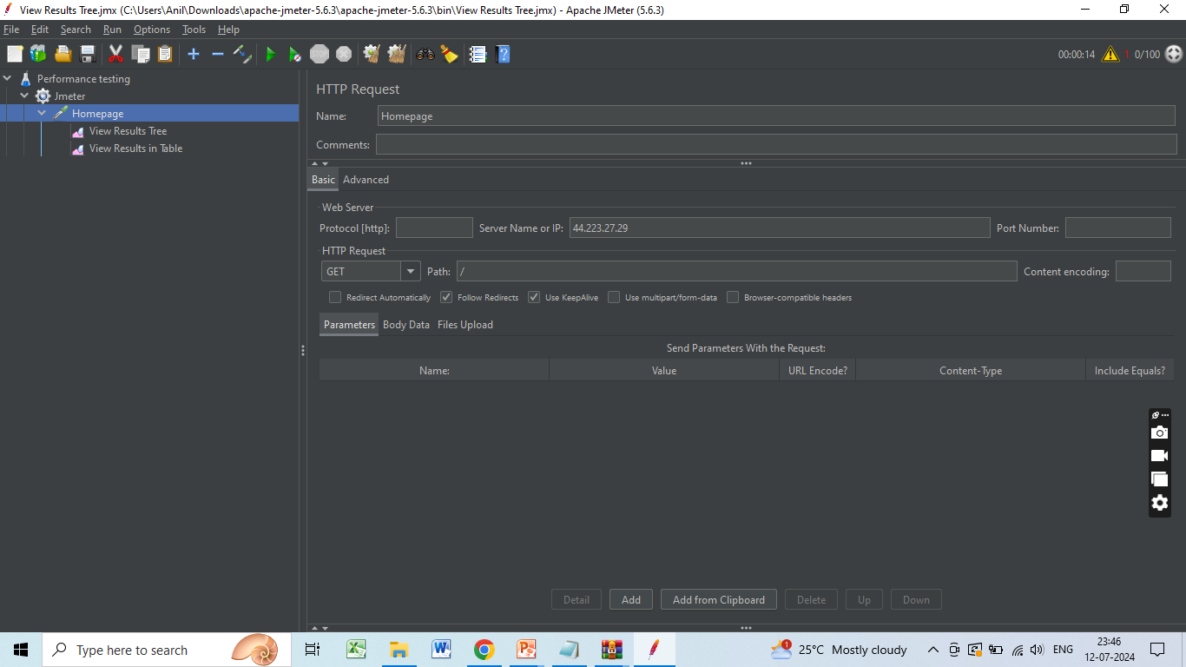

Slide 54
Add Listeners
To determine what the results of the test will be, you need to add some more test elements.
Right-click on Performance Testing
Go to listener options
For now, select the two of these:
View results in table
View results tree

Slide 55
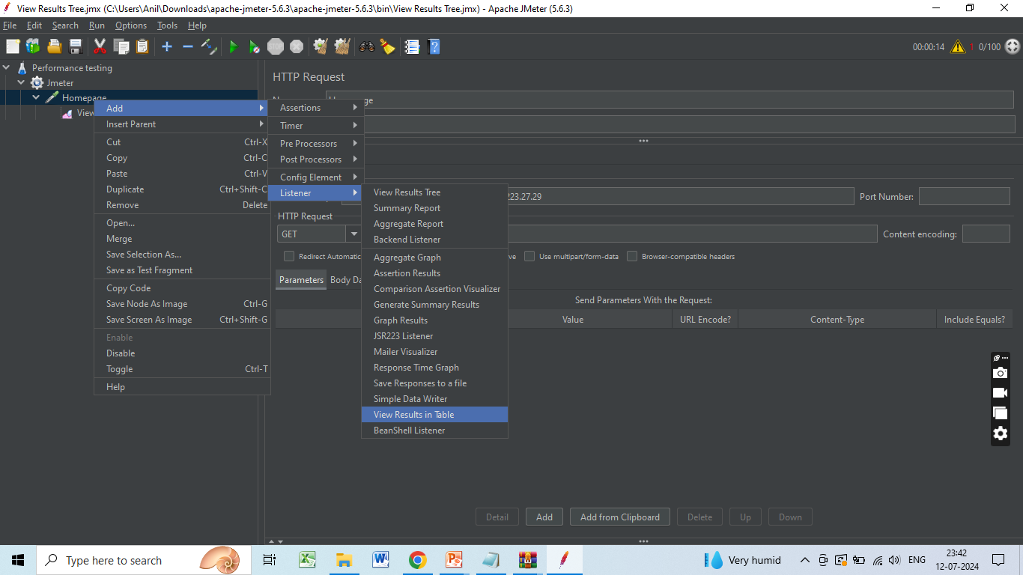

Slide 56
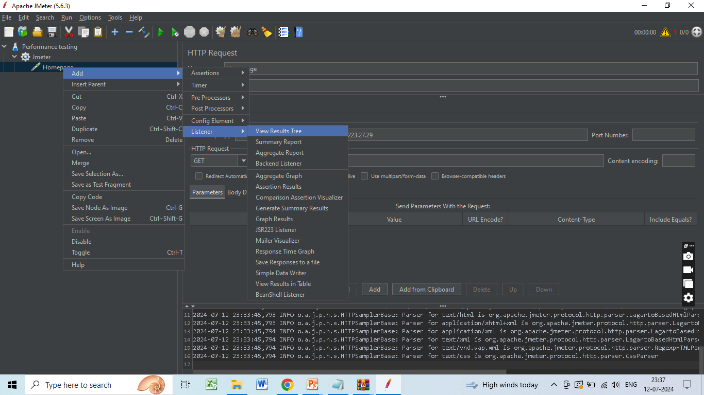

Slide 57
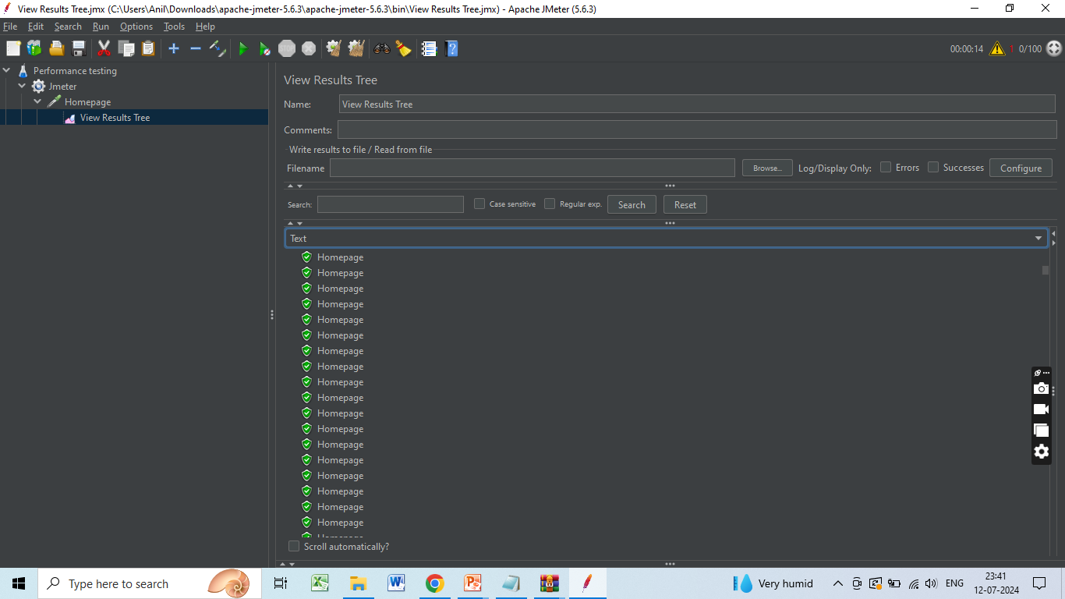
View results in tree

Slide 58
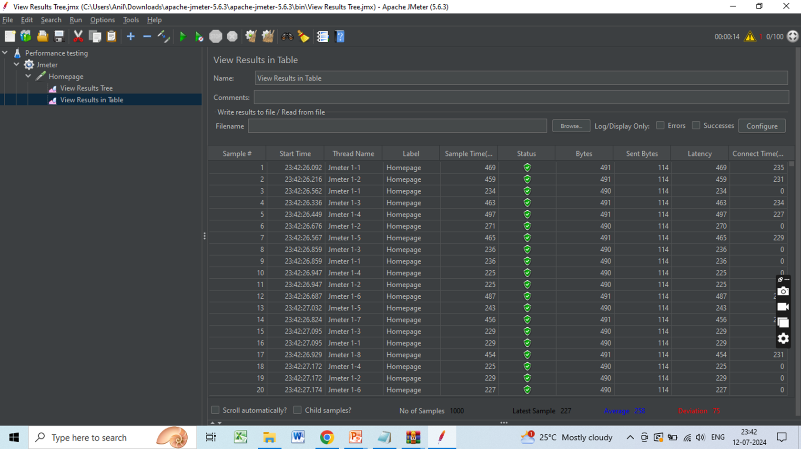
View results in table

Slide 59
CloudWatch for Monitoring and Logging
Configure EC2 to send application logs to Cloudwatch log groups
Create a new IAM role, select EC2 Service and this policy - CloudWatchAgentServerPolicy
Create a EC2 instance, allow ssh port and attach the above IAM role to the instance.
Install java
sudo yum -y install java-1.8.0

Slide 60
Download the spring application jar file
sudo wget https://raw.githubusercontent.com/gaurav157243/aws-project/master/springboot-backend/springboot-backend.jar
Start the application in background and redirect the output to a file
sudo nohup java -jar springboot-backend.jar > /tmp/myapp.log 2> /tmp/myapp.log &
Install the cloudwatch agent using the following command:
sudo yum install amazon-cloudwatch-agent

Slide 61
Configure the cloudwatch agent using the following command. Specify the location of the myapp.log (/tmp/myapp.log) file during configuration.
sudo /opt/aws/amazon-cloudwatch-agent/bin/amazon-cloudwatch-agent-config-wizard
Starting the cloudwatch agent; use the config file returned from the above command:
sudo /opt/aws/amazon-cloudwatch-agent/bin/amazon-cloudwatch-agent-ctl -a fetch-config -m ec2 -s -c file:/opt/aws/amazon-cloudwatch-agent/bin/config.json
Check status:
sudo /opt/aws/amazon-cloudwatch-agent/bin/amazon-cloudwatch-agent-ctl -m ec2 -a status

Slide 62
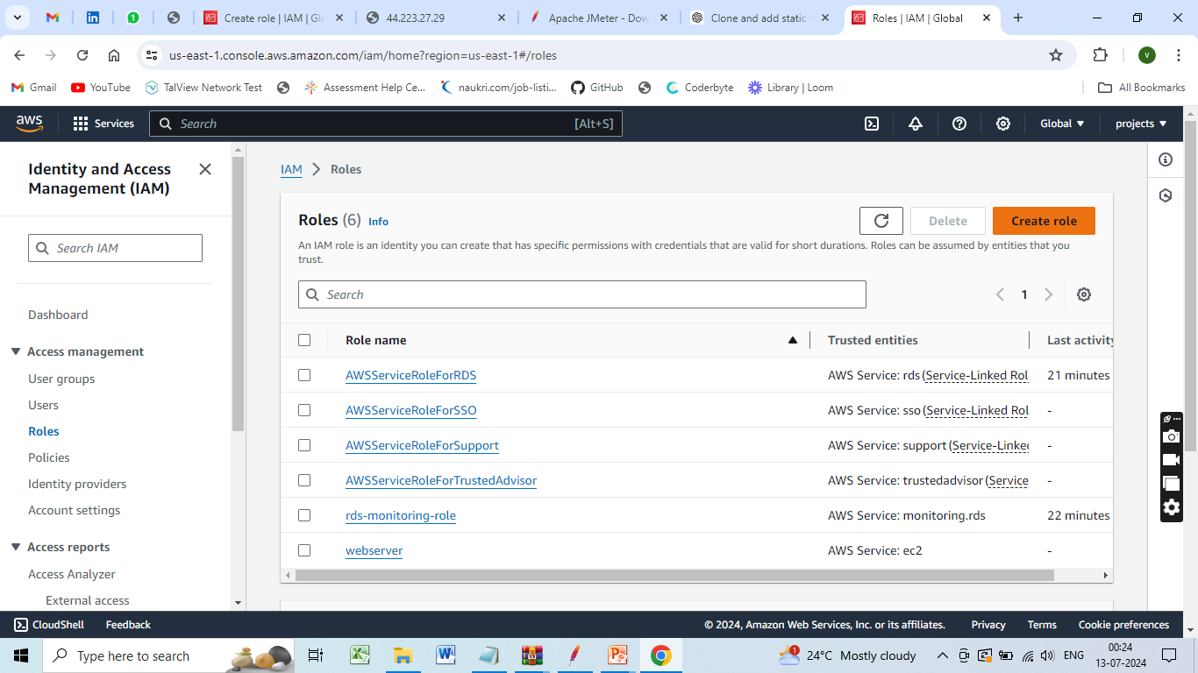
Create a IAM Role

Slide 63
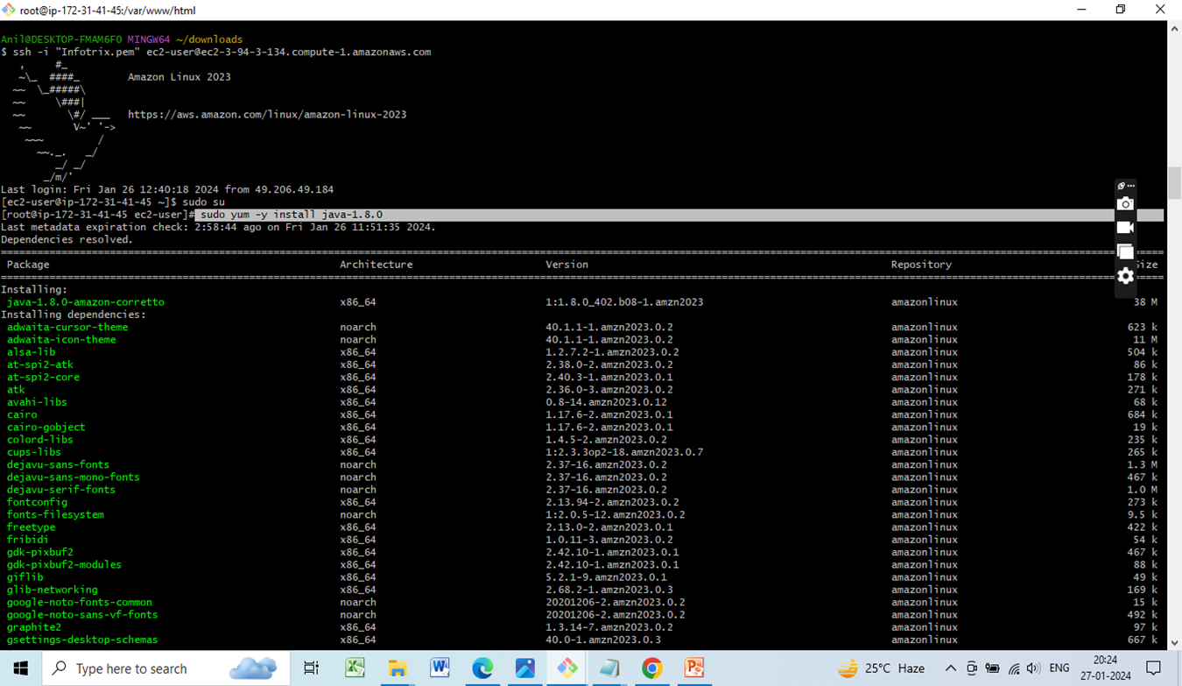
Install java sudo yum -y install java-1.8.0

Slide 64
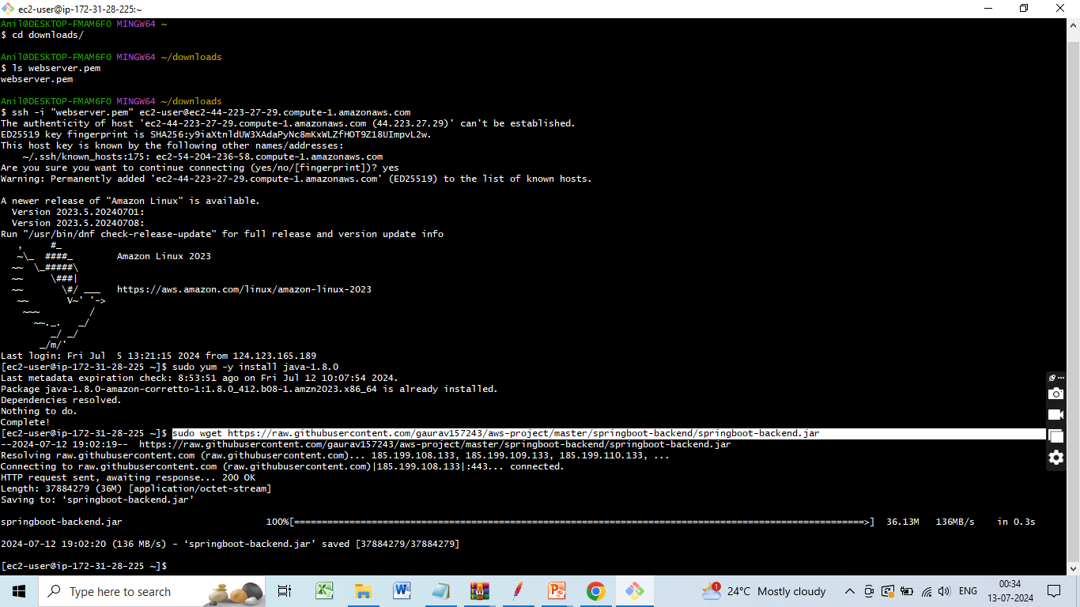
Download the spring application jar file

Slide 65
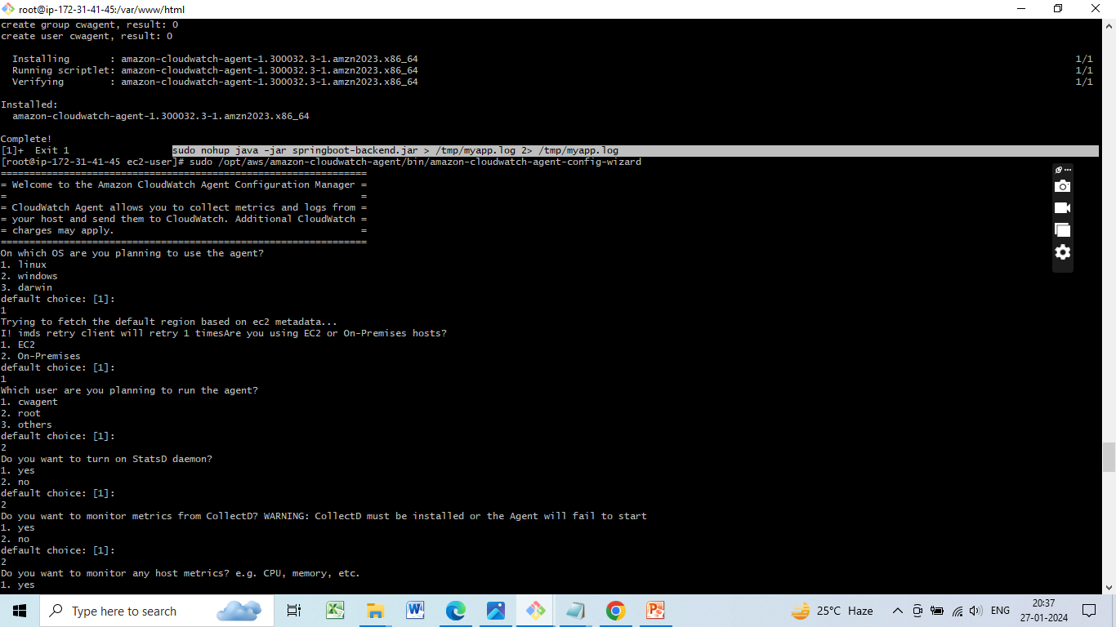
Start the application in background and redirect the output to a file

Slide 66
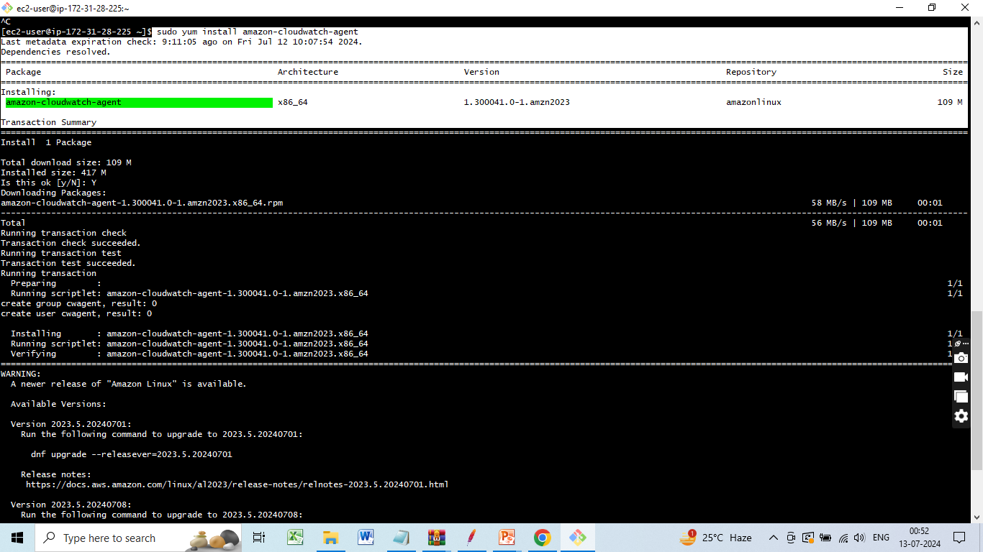
Installing the CloudWatch Agent

Slide 67
Configure the cloudwatch agent using the following command
sudo /opt/aws/amazon-cloudwatch-agent/bin/amazon-cloudwatch-agent-config-wizard

Slide 68
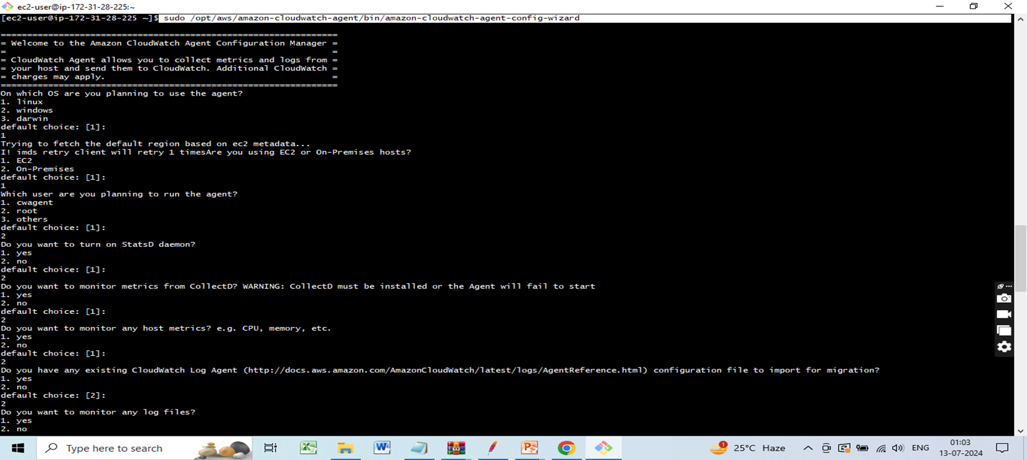

Slide 69
Starting the cloudwatch agent
sudo /opt/aws/amazon-cloudwatch-agent/bin/amazon-cloudwatch-agent-ctl -a fetch-config -m ec2 -s -c file:/opt/aws/amazon-cloudwatch-agent/bin/config.json

Slide 70
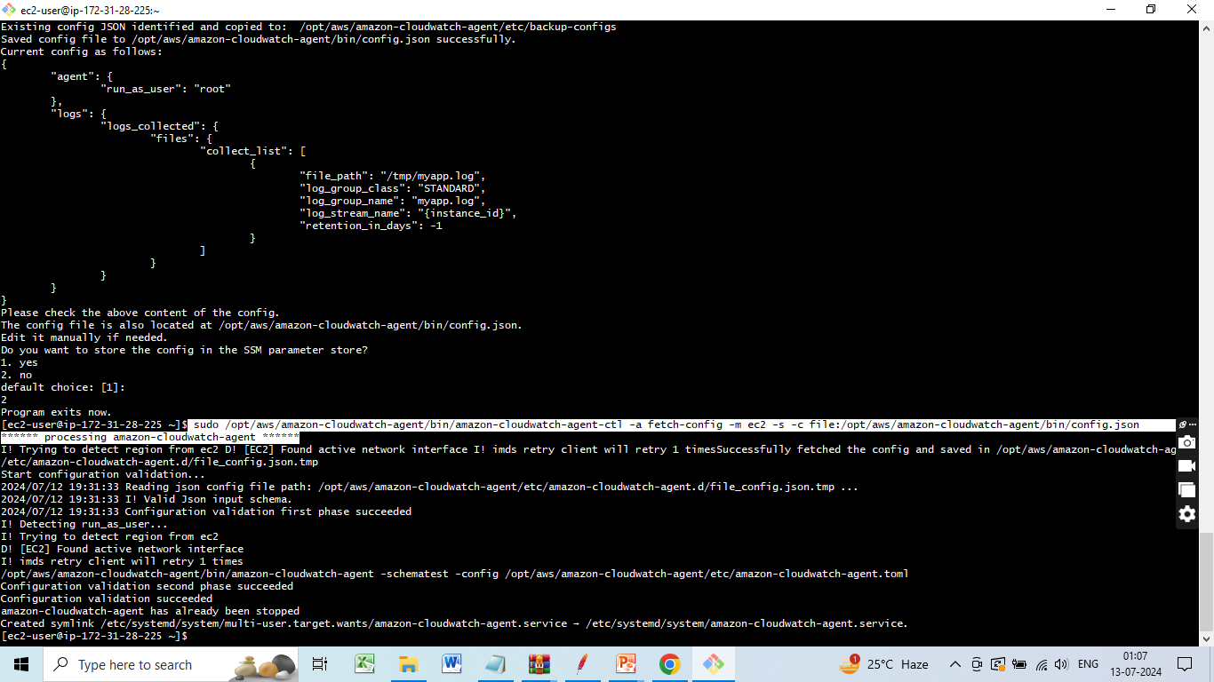

Slide 71
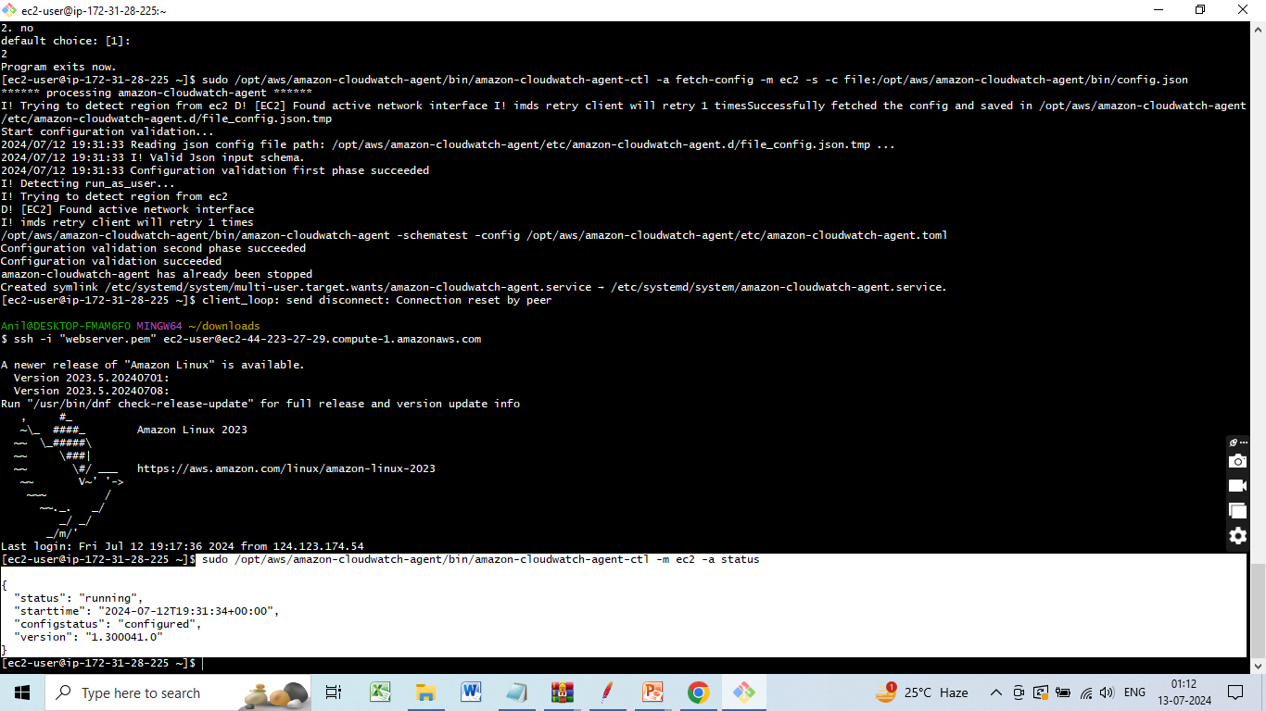
Check status
sudo /opt/aws/amazon-cloudwatch-agent/bin/amazon-cloudwatch-agent-ctl -m ec2 -a status

Slide 72
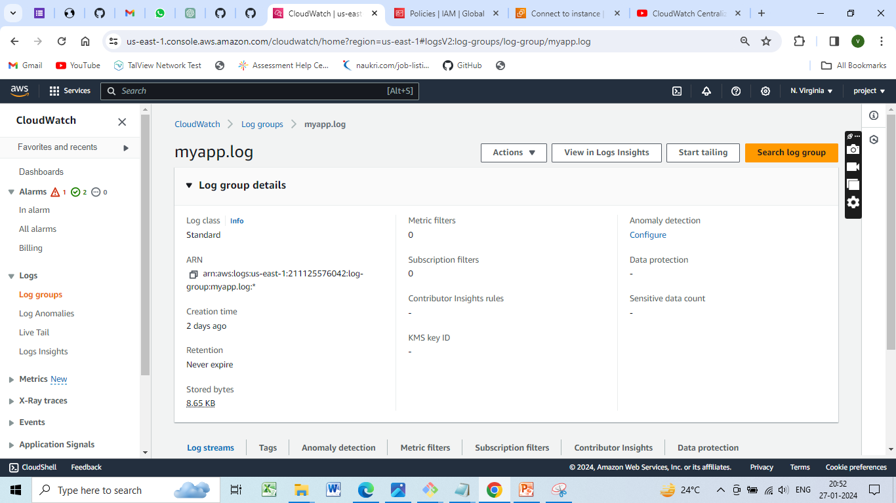
Check Cloudwatch
Log groups and search for myapp.log and you will see your applications log.

Slide 73
Resources and References:
AWS Documentation: AWS Documentation
AWS IAM Documentation: IAM Documentation
AWS EC2 Documentation: EC2 Documentation
AWS RDS Documentation: RDS Documentation
AWS Elastic Load Balancing Documentation: ELB Documentation
AWS Auto Scaling Documentation: Auto Scaling Documentation
AWS Security Best Practices: Security Best Practices

Slide 74
CONCLUSION
Deploying a scalable web application on AWS ensures high availability, performance, and security by using various AWS services. Proper design, resource provisioning, security implementation, and continuous monitoring enable a robust and efficient deployment, providing a reliable and seamless user experience.

Slide 75


